Slide 1
Discrete Mathematics BCSC 0010 Group Theory

Slide 2
Group
Qs. In Z we define define (a*b= a+b+1), show it is an abelian.
Ans: An abelian holds five properties simultaneously –
Closure, Associative, Identity, inverse, commutative

Slide 3
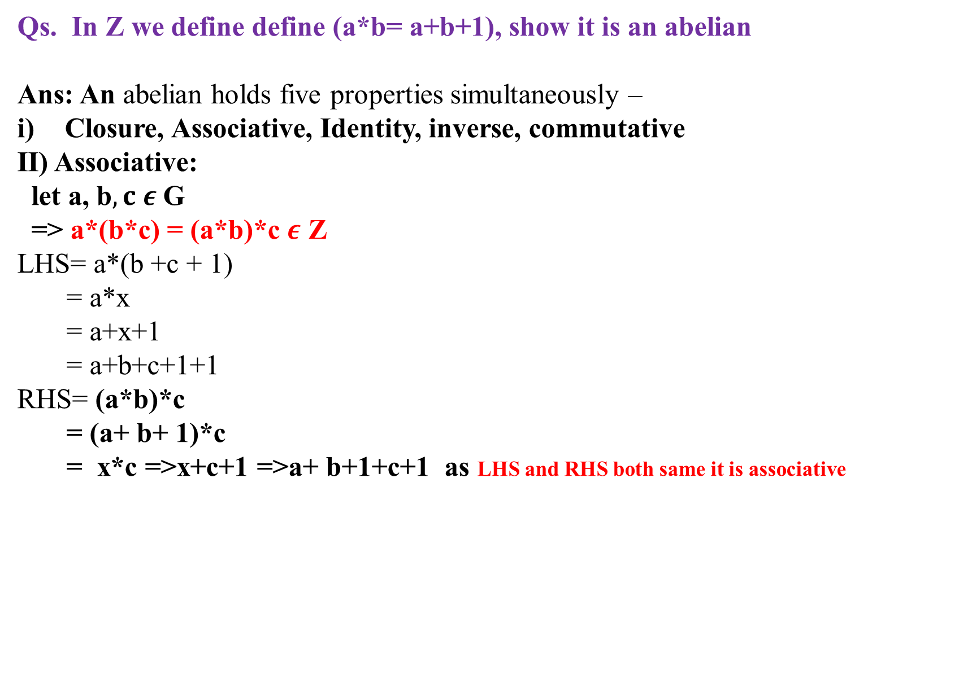
Qs. In Z we define define (a*b= a+b+1), show it is an abelian
Ans: An abelian holds five properties simultaneously –
Closure, Associative, Identity, inverse, commutative
II) Associative:
let a, b$, c ε$ G
=> a*(b*c) = (a*b)*c $ε$ Z
LHS= a*(b +c + 1)
= a*x
= a+x+1
= a+b+c+1+1
RHS= (a*b)*c
= (a+ b+ 1)*c
= x*c =>x+c+1 =>a+ b+1+c+1 as LHS and RHS both same it is associative

Slide 4
Qs. In Z we define define (a*b= a+b+1), show it is an abelian
(iii) Identity :
Let a ∈ Z
Multiplication is there a* e= a
a*e= a +e + 1=a
e+ 1=0
e = -1 ∈ Z
So identity element e= -1

Slide 5
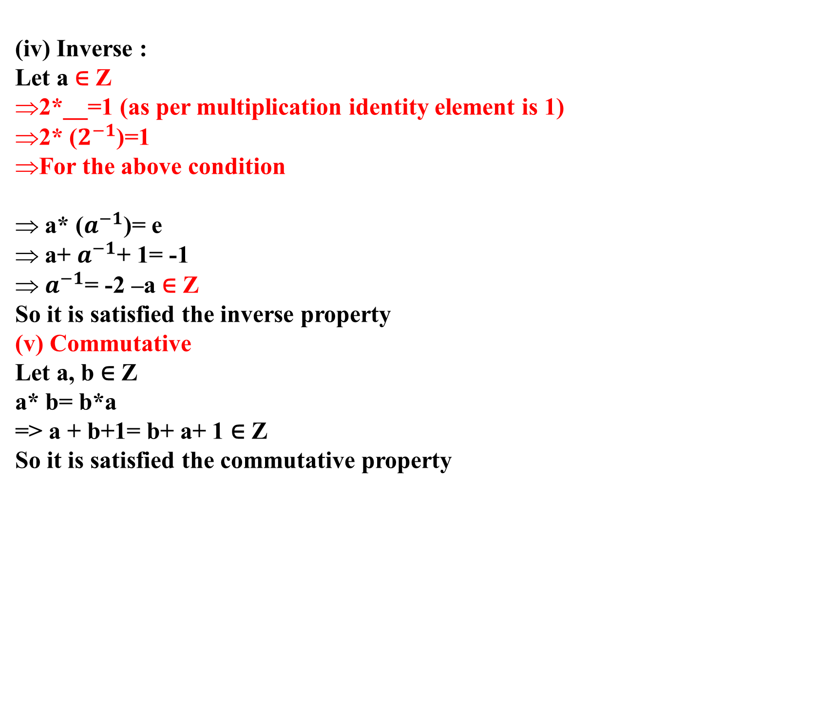
(iv) Inverse :
Let a ∈ Z
2*__=1 (as per multiplication identity element is 1)
2* ($2^{−1}$)=1
For the above condition
a* ($a^{−1}$)= e
a+ $a^{−1}$+ 1= -1
$a^{−1}$= -2 –a ∈ Z
So it is satisfied the inverse property
(v) Commutative
Let a, b ∈ Z
a* b= b*a
=> a + b+1= b+ a+ 1 ∈ Z
So it is satisfied the commutative property

Slide 6
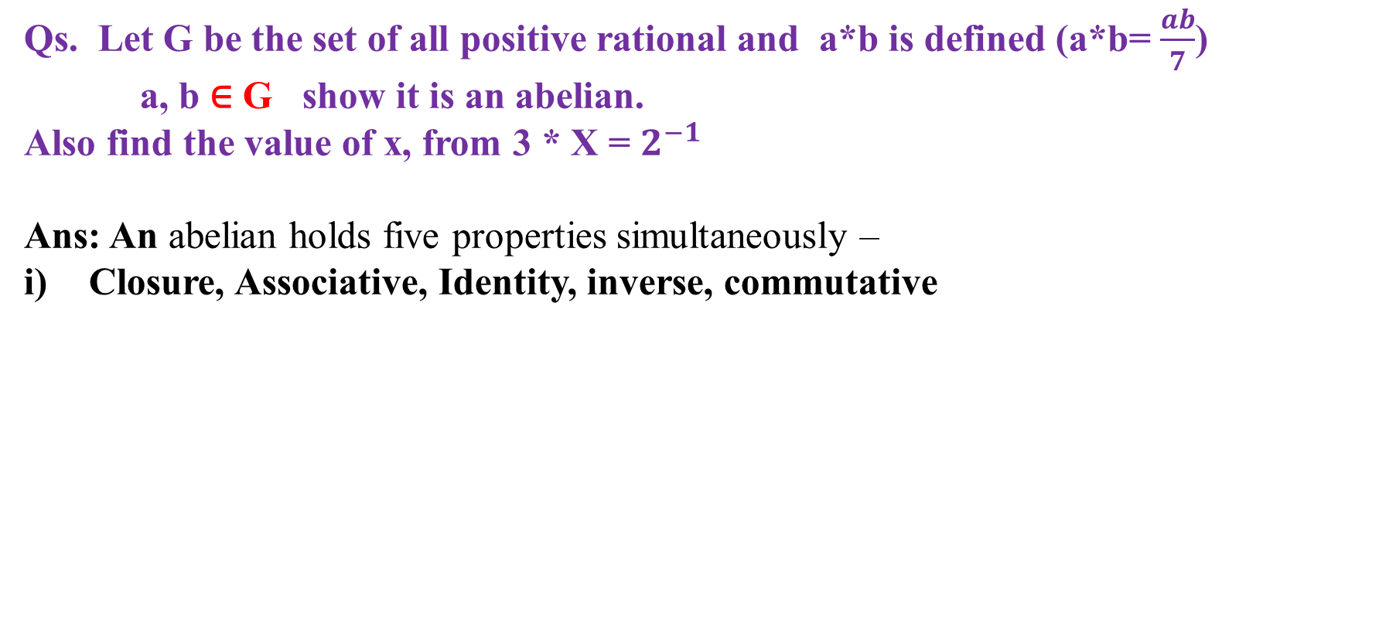
Qs. Let G be the set of all positive rational and a*b is defined (a*b= $\frac{ab}{7}$) a, b ∈ G show it is an abelian.
Also find the value of x, from 3 * X = $2^{−1}$
Ans: An abelian holds five properties simultaneously –
Closure, Associative, Identity, inverse, commutative

Slide 7

Closure
Let a,b ∈ G
a*b= $\frac{ab}{7}$∈ G
Closure is satisfied
II) Associative:
let a, b$, c ε$ G
=> a*(b*c) = (a*b)*c $ε$ Z
LHS= a*($\frac{bc}{7}$)
= a*x
= ($\frac{ax}{7})$
= $\frac{abc}{49}$
RHS= (a*b)*c
= ($\frac{ab}{7}$)*c
= x*c => ($\frac{cx}{7})$=> $\frac{abc}{49}$
as LHS and RHS both same it is associative

Slide 8

(iii) Identity :
Let a ∈ G
Multiplication is there a*b= $\frac{ab}{7}$
a*e= $\frac{ae}{7}$=a
e=7
e = 7 ∈ G
So identity element e= 7

Slide 9

(iv) Inverse :
Let a ∈ G
a*b= $\frac{ab}{7}$
a* ($a^{−1}$)= e
$\frac{aa^{−1}}{7}$=7
$a^{−1}$= $\frac{49}{a}$∈ G
So it is satisfied the inverse property
(v) Commutative
Let a, b ∈ Z
a* b= b*a
=> $\frac{ab}{7}$= $\frac{ba}{7}$∈ G
So it is satisfied the commutative property

Slide 10

3 * X = $2^{−1}$
As we know that a* b= $\frac{ab}{7}$
3*X= $\frac{3X}{7}$---------(1)
Also we found $a^{−1}$= $\frac{49}{a}$, $2^{−1}=\frac{49}{2}$----------(2)
From (1) and (2)
$\frac{3X}{7}$= $\frac{49}{2}$
=> x= $\frac{49∗7}{2∗3}$

Slide 11
Qs. Show that the cube root of Unity is an abelian group under multiplication.
Ans: An abelian holds five properties simultaneously –
Closure, Associative, Identity, inverse, commutative

Slide 12

Ans: X= $\sqrt[3]{1}$
=> x= $1^{1/3}$
$x^{3}$ = 1
$x^{3}$ - 1=0
(x-1) ($x^{2}$ +x+1)=0
X=1, x=$\frac{−1±i\sqrt{3}}{2}$
X have 3 term asroot
X = 1, $\frac{−1+i\sqrt{3}}{2}$, $\frac{−1−i\sqrt{3}}{2}$
1 w ${ w}^{2}$

Slide 13
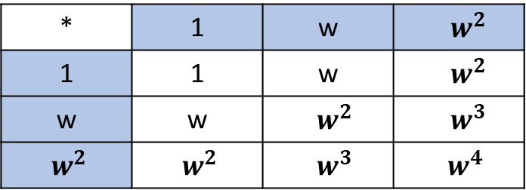

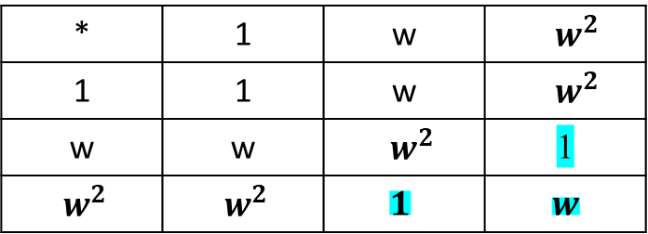
Ans: X= $\sqrt[3]{1}$
=> x= $1^{1/3}$
$x^{3}$ = 1
$x^{3}$ - 1=0
(x-1) ($x^{2}$ +x+1)=0
X=1, x=$\frac{−1±i\sqrt{3}}{2}$
X have 3 term asroot
X = 1, $\frac{−1+i\sqrt{3}}{2}$, $\frac{−1−i\sqrt{3}}{2}$
1 w ${ w}^{2}$
${ w}^{3}$ =1, ${ w}^{4}=w$
* | 1 | w | ${ w}^{2}$
1 | 1 | w | ${ w}^{2}$
w | w | ${ w}^{2}$ | ${ w}^{3}$
${ w}^{2}$ | ${ w}^{2}$ | ${ w}^{3}$ | ${ w}^{4}$
* | 1 | w | ${ w}^{2}$
1 | 1 | w | ${ w}^{2}$
w | w | ${ w}^{2}$ | 1
${ w}^{2}$ | ${ w}^{2}$ | $$1$$ | $w$

Slide 14
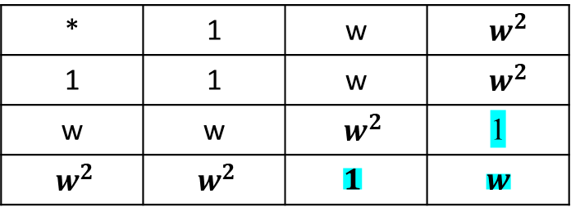
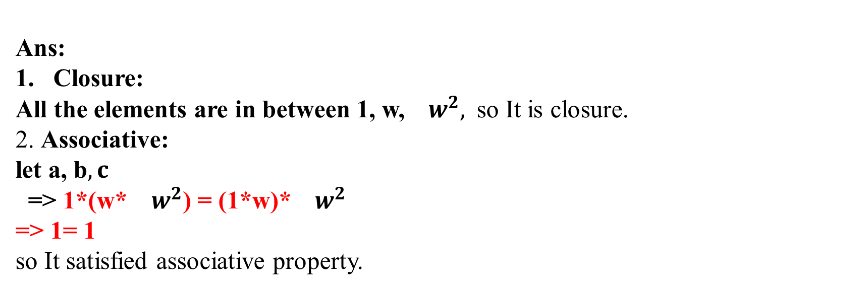
* | 1 | w | ${ w}^{2}$
1 | 1 | w | ${ w}^{2}$
w | w | ${ w}^{2}$ | 1
${ w}^{2}$ | ${ w}^{2}$ | $$1$$ | $w$
Ans:
Closure:
All the elements are in between 1, w, ${ w}^{2},$ so It is closure.
2. Associative:
let a, b$, c$
=> 1*(w* ${ w}^{2}$) = (1*w)* ${ w}^{2}$
=> 1= 1
so It satisfied associative property.

Slide 15
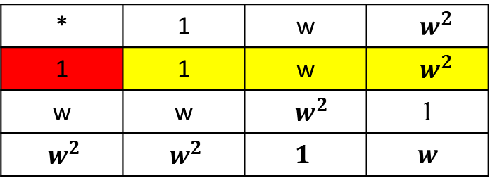
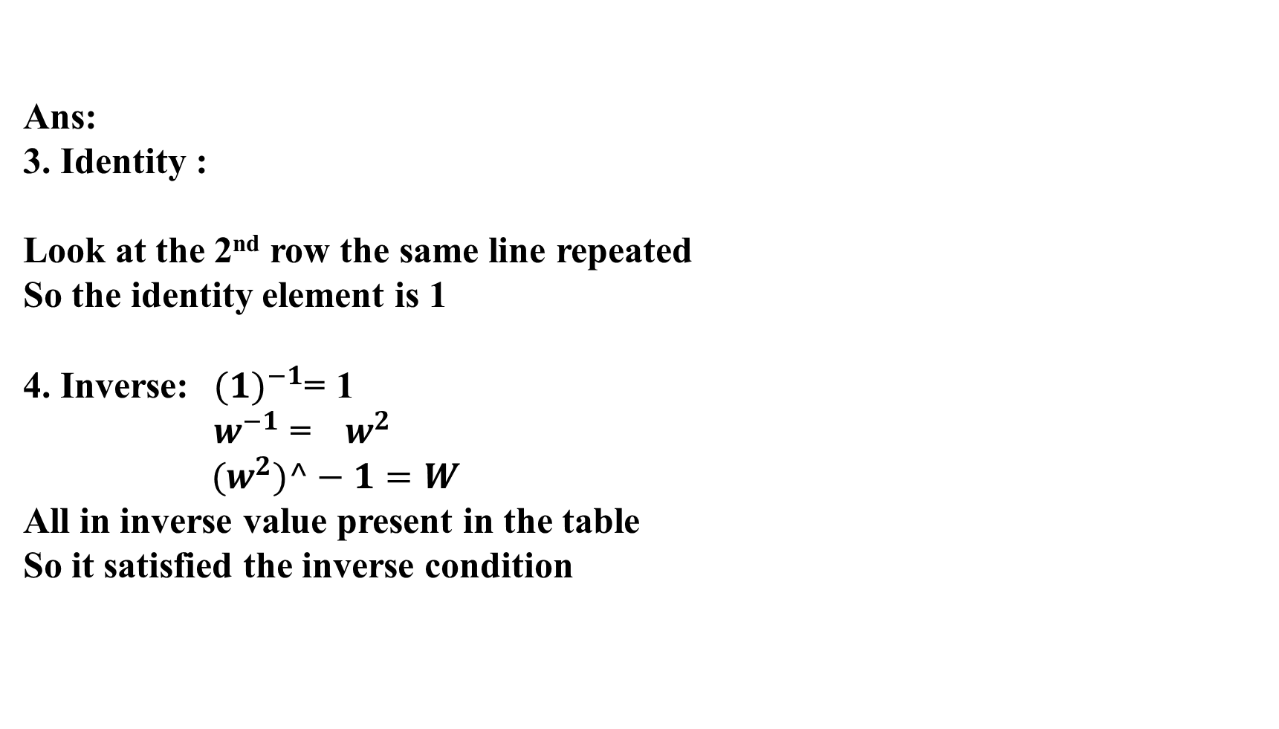
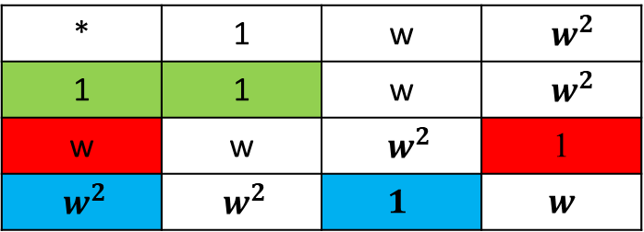
Ans:
3. Identity :
Look at the 2nd row the same line repeated
So the identity element is 1
4. Inverse:${ (1)}^{−1}$= 1
${ w}^{−1}$ = ${ w}^{2}$
$${ (w}^{2})^−1=W$$
All in inverse value present in the table
So it satisfied the inverse condition
* | 1 | w | ${ w}^{2}$
1 | 1 | w | ${ w}^{2}$
w | w | ${ w}^{2}$ | 1
${ w}^{2}$ | ${ w}^{2}$ | $$1$$ | $w$
* | 1 | w | ${ w}^{2}$
1 | 1 | w | ${ w}^{2}$
w | w | ${ w}^{2}$ | 1
${ w}^{2}$ | ${ w}^{2}$ | $$1$$ | $w$

Slide 16
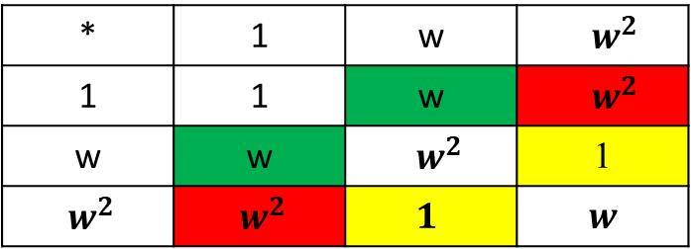
Ans:
5. commutative :
If we draw a diagonal in the
Given table then can find symmetricity,
So it satisfied the commutative condition
* | 1 | w | ${ w}^{2}$
1 | 1 | w | ${ w}^{2}$
w | w | ${ w}^{2}$ | 1
${ w}^{2}$ | ${ w}^{2}$ | $$1$$ | $w$

Slide 17

Qs. Show that the set G = {1, −1, i, −i} where i = $\sqrt{−1}$, is an abelian group with respect to multiplication as a binary operation.
Ans: An abelian holds five properties simultaneously –
Closure, Associative, Identity, inverse, commutative

Slide 18
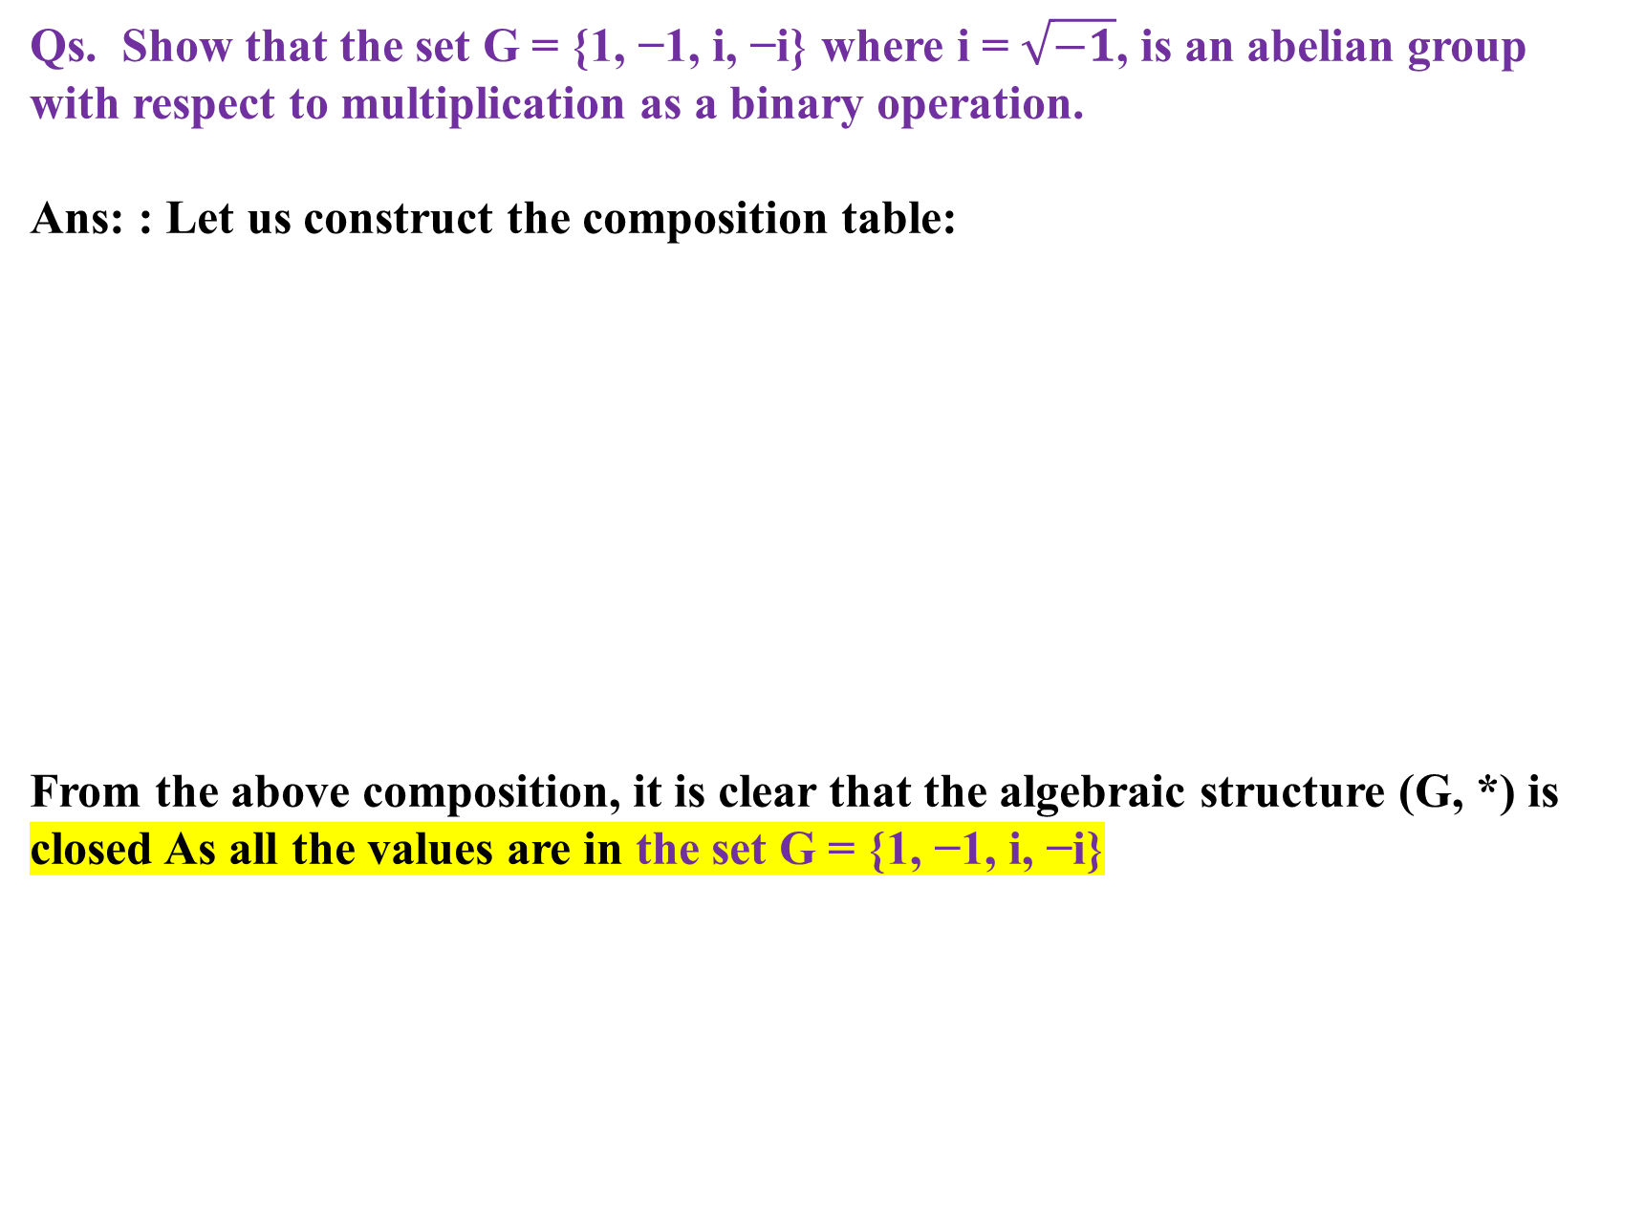
Qs. Show that the set G = {1, −1, i, −i} where i = $\sqrt{−1}$, is an abelian group with respect to multiplication as a binary operation.
Ans: : Let us construct the composition table:
From the above composition, it is clear that the algebraic structure (G, *) is closed As all the values are in the set G = {1, −1, i, −i}
* | 1 | -1 | i | -i
1 | 1 | -1 | i | -i
-1 | -1 | 1 | -i | i
i | i | -i | -1 | 1
-i | -i | i | 1 | -1

Slide 19
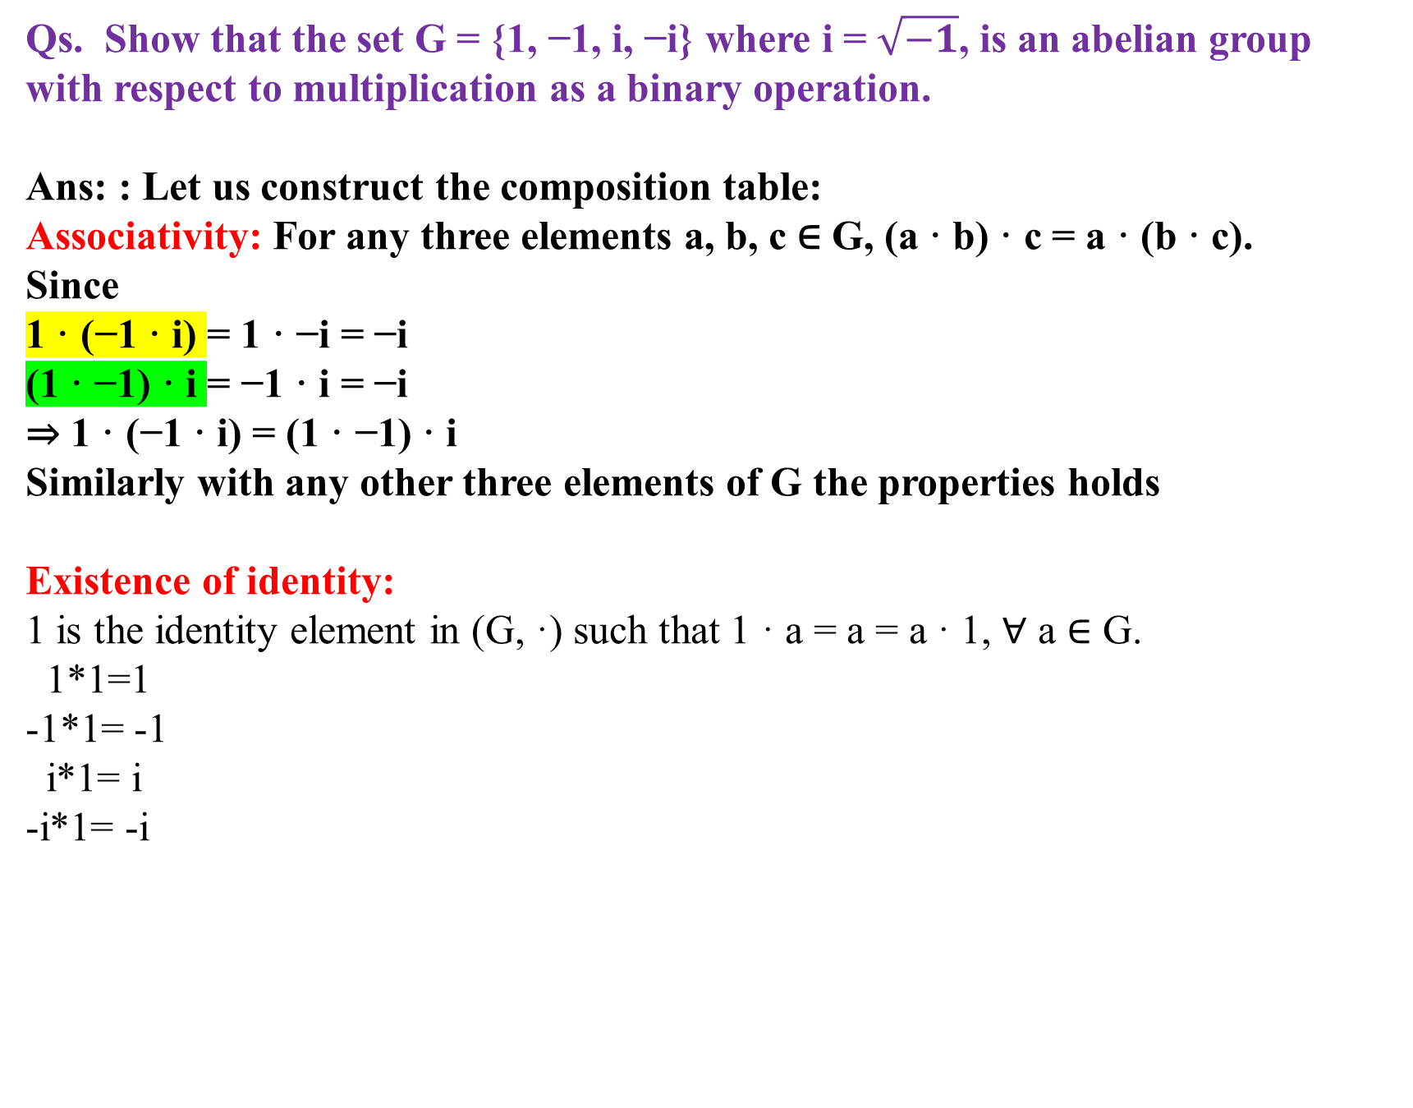
Qs. Show that the set G = {1, −1, i, −i} where i = $\sqrt{−1}$, is an abelian group with respect to multiplication as a binary operation.
Ans: : Let us construct the composition table:
Associativity: For any three elements a, b, c ∈ G, (a · b) · c = a · (b · c).
Since
1 · (−1 · i) = 1 · −i = −i
(1 · −1) · i = −1 · i = −i
⇒ 1 · (−1 · i) = (1 · −1) · i
Similarly with any other three elements of G the properties holds
Existence of identity:
1 is the identity element in (G, ·) such that 1 · a = a = a · 1, ∀ a ∈ G.
1*1=1
-1*1= -1
i*1= i
-i*1= -i

Slide 20
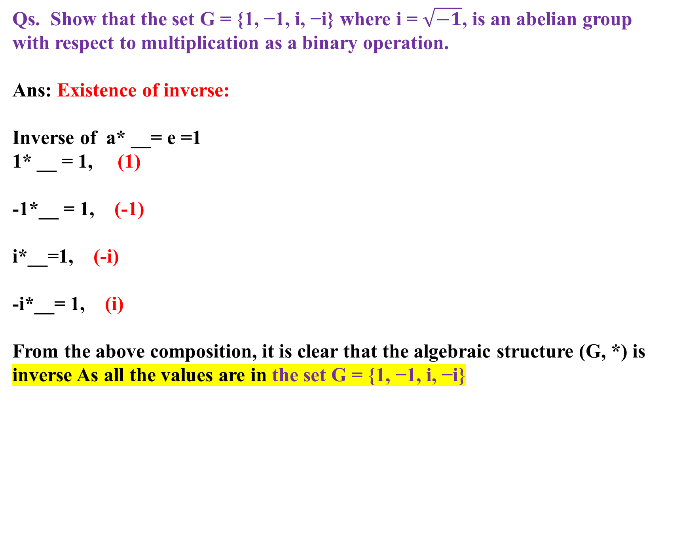
Qs. Show that the set G = {1, −1, i, −i} where i = $\sqrt{−1}$, is an abelian group with respect to multiplication as a binary operation.
Ans: Existence of inverse:
Inverse of a* __= e =1
1* __ = 1, (1)
-1*__ = 1, (-1)
i*__=1, (-i)
-i*__= 1, (i)
From the above composition, it is clear that the algebraic structure (G, *) is inverse As all the values are in the set G = {1, −1, i, −i}
* | 1 | -1 | i | -i
1 | 1 | -1 | i | -i
-1 | -1 | 1 | -i | i
i | i | -i | -1 | 1
-i | -i | i | 1 | -1

Slide 21
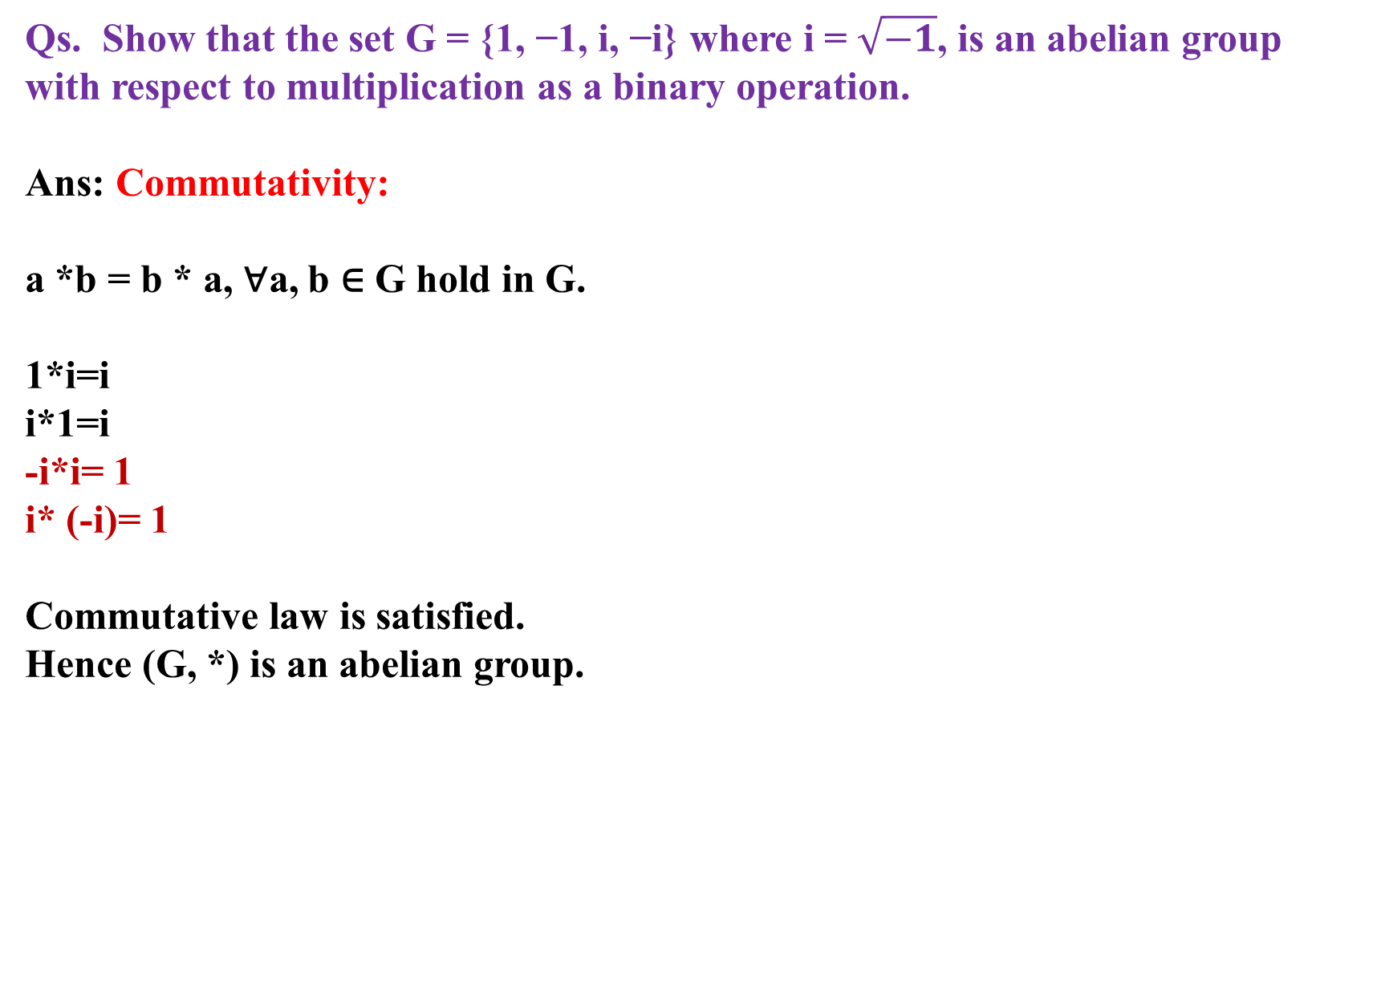
Qs. Show that the set G = {1, −1, i, −i} where i = $\sqrt{−1}$, is an abelian group with respect to multiplication as a binary operation.
Ans: Commutativity:
a *b = b * a, ∀a, b ∈ G hold in G.
1*i=i
i*1=i
-i*i= 1
i* (-i)= 1
Commutative law is satisfied.
Hence (G, *) is an abelian group.

